Slide 1
Hybrid Search Midpoint Presentation
Group A
Chaman Ali | 15016005
Surendra Dura | 15007669
Keith Feeney | 15015556
Chenlei Jie | 01318877
Business Application Development | June 2018

Slide 2
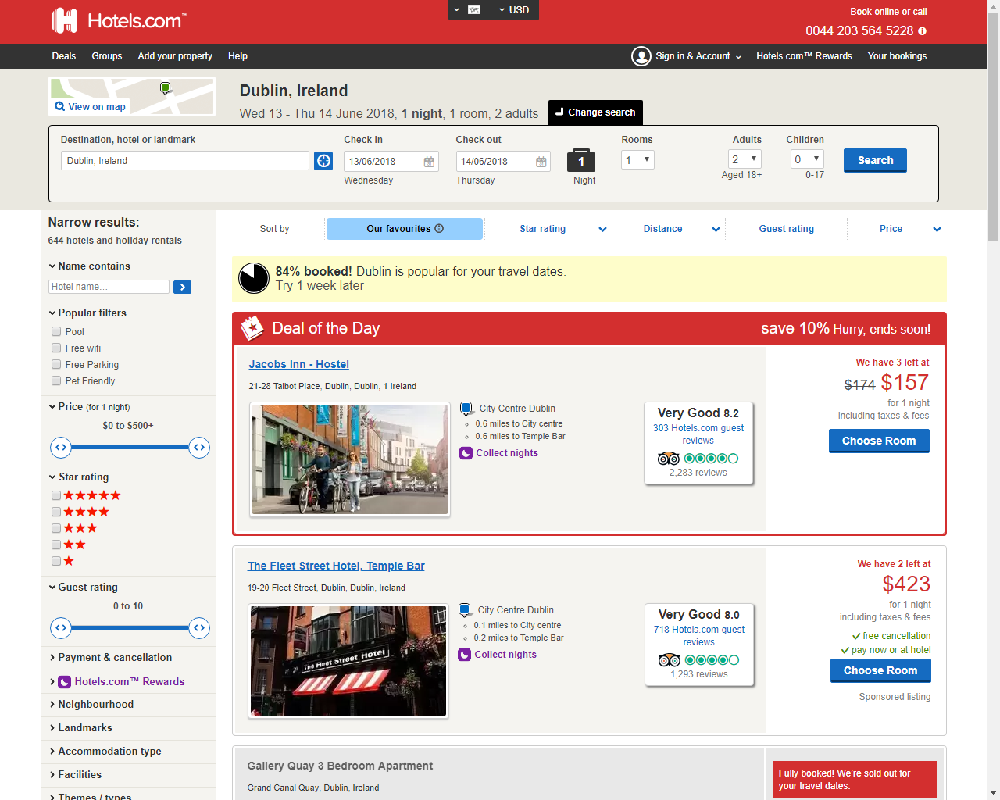
Introduction & Project Background
Meta-searching website
Examples of meta-searching websites:
Hotels.com
Trivago
CheapFlights.com
(Hotels.com, 2018)

Slide 3

Introduction & Project Background
For the OAP market
Services will be included:
HSE
Local GP information
Hospital information.
Events will be added.
(Public domain)

Slide 4
Scrum
What we have done (User Stories)
Sprints 1-3
Daily Meeting
Future Sprint and work

Slide 5
What we have done (User Stories)
Completed
Add Events – Chenlei (Sprint 1-3)
User Reg/Login – Keith (Sprint 1-3)
Admin Page – Surendra (Sprint 1-2)
On Prograss
Searching – Ali (Sprint 1-5)
Customer Save – Surendra (Sprint 3)

Slide 6

What we have done (User Stories)
Why we choose those tasks?
By Priority
(Nasir1164, n.d.)

Slide 7

Daily Meeting
What did you do?
What are you going to do for today?
Issues?
(askdiverged.cf, n.d.)

Slide 8
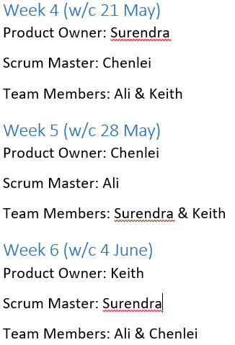
Sprints 1-3 (Roles)

Slide 9
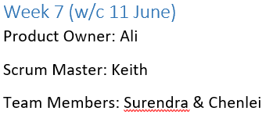
Future Sprint and work
Sprint 4
Customer Save – Surendra
Searching – Ali
Company Edit –Chenlei
User Edit Account - Keith

Slide 10






Technology used
(Pardee, n.d.)
(quantum-coders.com, n.d.)
(coldhair, 2017)
(Kamis, 2012)
(RuhiNaaz Md.Saleem, 2018)
(evensi.us, 2018)

Slide 11
Demonstration

Slide 12
Questions?
Sprint 4
Customer Save – Surendra
Searching – li
Company Edit –Chenlei
User Edit Account - Keith

Slide 13
References
Hotels.com, 2018, image, viewed 11 June 2018, <http://hotels.com>.
Nasir1164, n.d, image, viewed 11 June 2018, <https://thumbs.dreamstime.com/z/d-person-writing-priorities-transparent-screen-rendering-man-marker-glass-white-people-character-50494083.jpg>.
askdiverged.cf, n.d., image, viewed 11 June 2018, <http://aeroleads.com/blog/wp-content/uploads/2017/06/Aeroleads-sales-meeting.jpg>.
Pardee, M, n.d., image, viewed 11 June 2018, <http://acom.azurecomcdn.net/80C57D/blogmedia/migratedblogimages/2337.Cloud9.png>.
quantum-coders.com, n.d., image, viewed 11 June 2018, <https://www.quantum-coders.com/sites/all/themes/tyger/images/services/html5-css3.png>.
coldhair, 2017, image, viewed 11 June 2018, <https://steemitimages.com/DQmcYYQUiE6QkwdDQf8wW8XumaHfw5VUE121PWD5r5tM7fY/image.png>.
Kamis, 2012, image, viewed 11 June 2018, <https://softwareinovator.files.wordpress.com/2012/12/logo-mysql.jpg?w=775>.
RuhiNaaz Md.Saleem, 2018, image, viewed 11 June 2018, <http://alnayrtech.com/wp-content/uploads/bootrap-2.png>.
evensi.us, 2018, image, viewed 11 June 2018, <https://secure.meetupstatic.com/photos/event/d/a/1/2/highres_433555826.jpeg>.

